Slide 1

Semiconductor Shortage Case Study (2020–2023)
How a perfect storm of demand shifts, supply shocks, and geopolitics stretched lead times, idled factories, and reshaped industrial policy—and what resilient operators did differently.
Demand
Supply
Policy
Resilience

Slide 2
Agenda
01
02
03
Root Causes
Supply Chain Anatomy + Fab Capacity Map
Lead-Time Trend (2020–2023)
Understanding the convergence of shocks
Component availability timeline
Global production infrastructure
04
05
06
Impacted Sectors
Mitigation Levers
Policy Incentives (CHIPS Acts)
Who was hit and how
Tactical responses that worked
Government response worldwide
07
08
09
Risk Heatmap
Resilience Playbook
Recovery Timeline
Vulnerability assessment
From firefighting to foresight
Shock, squeeze, response, recovery

Slide 3

Root Causes: A Convergence of Shocks
The semiconductor shortage emerged from the simultaneous collision of multiple disruptions across demand, supply, structure, and geopolitics. No single factor drove the crisis—instead, cascading shocks amplified constraints across the value chain.
Pandemic and Operations
Demand Mix Shift
COVID demand whiplash: early auto cancellations, then sharp rebound
Work-from-home surge drove PC, networking, and data center demand
Factory disruptions: lockdowns in critical regions
Automotive electrification increased semiconductor content per vehicle
Texas freeze (2021) impacted fab operations
ADAS features expanded chip requirements
Japan fab fire and Malaysia OSAT lockdowns
Console and GPU cycles intensified competition for capacity
Industry Structure
Geopolitics and Policy
Tight mature-node capacity (90–28nm, 8-inch lines) for MCUs, analog, and power
Export controls and licensing scrutiny added friction
Logistics constraints magnified delivery delays
Long equipment lead times for critical tooling
Component allocation practices created market distortions
Capex prioritized at advanced nodes, leaving mature nodes constrained
Strategic competition intensified capacity concerns
Limited flexibility to shift production between nodes

Slide 4






Semiconductor Supply Chain at a Glance
The semiconductor supply chain is a globally distributed, capital-intensive network with long lead times and limited substitutability. Understanding the stages and their bottlenecks is essential to diagnosing the shortage.
Design/IP
Players: IDMs, fabless companies, EDA vendors, IP providers
Wafer Fabrication
Players: Foundries (TSMC, Samsung, UMC, GF, SMIC), IDMs
Bottleneck: Mature-node fab capacity (8-inch, 200mm tools); long equipment lead times
Assembly/Test (OSAT)
Players: ASE, Amkor, JCET, SPIL; significant Southeast Asia footprint
Bottleneck: OSAT throughput and labor availability
Distribution
Players: Avnet, Arrow; franchised and independent channels
OEM/EMS
Players: Automotive, Consumer, Industrial, Telecom; EMS integrators
Bottleneck: Qualification cycles for alternates in safety-critical domains
Key Insight: Bottlenecks concentrated in mature-node fab capacity, OSAT throughput, equipment availability, and qualification timelines—areas that cannot quickly scale even with unlimited capital.

Slide 5
Global Fab Capacity Map (Indicative)
Semiconductor manufacturing is geographically concentrated, with distinct regional specializations and capabilities. The shortage exposed vulnerabilities in this concentrated supply base and accelerated investment in diversification.
Taiwan
Focus: Advanced and mature logic (TSMC, UMC)
Largest global share of leading-edge nodes; critical dependency for advanced semiconductors
South Korea
Focus: Logic and memory (Samsung, SK hynix)
Advanced logic and DRAM/NAND scale; vertically integrated capabilities
United States
Focus: IDM and foundry expansion (Intel, GF, TSMC Arizona)
CHIPS-funded greenfield and brownfield projects aim to rebuild domestic capacity
Mainland China
Focus: Mature nodes and memory
Domestic capacity build constrained by export control measures on advanced tooling
EU (incl. Germany)
Focus: Automotive/industrial; new fab sites
EU Chips Act-supported projects target strategic resilience in key sectors
Japan
Focus: Mature/advanced (TSMC Kumamoto), specialty processes
Strong OSAT, materials, and equipment ecosystem supports regional production
SEA (Malaysia, Singapore)
Focus: OSAT/test; some fabs (GF Singapore)
Critical for final assembly and test throughput; lockdowns had cascading impacts

Slide 6
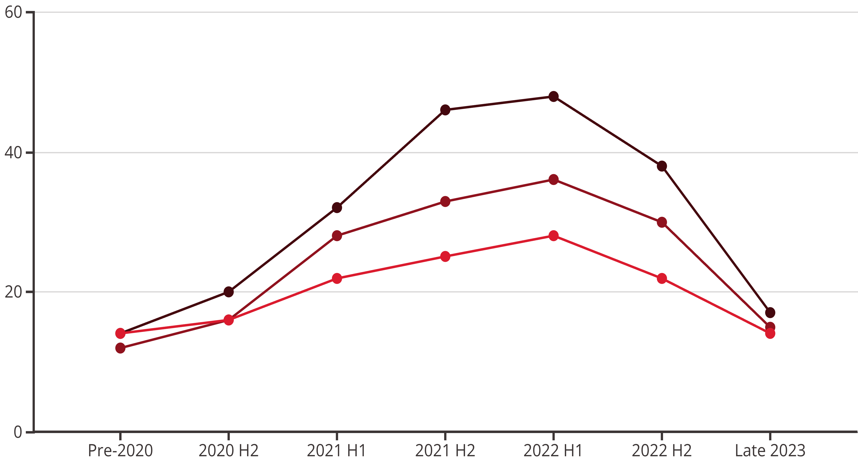
Lead-Time Trend (Weeks): 2020–2023
Lead times—the gap between order and delivery—ballooned during the shortage, especially for mature-node products. MCUs and analog components saw the most extreme extensions, with peak lead times exceeding 40 weeks. By late 2023, normalization was underway but remained uneven across categories.
MCUs
Analog
Power
Key Observations
Shock Events
Mature-node categories (MCUs, analog, power) peaked highest
2021 shocks: Weather events (Texas freeze), fab fires, OSAT lockdowns amplified constraints
Memory cycled sooner due to faster capacity response
Recovery unevenness: By late 2023, normalization varied significantly by component category and supplier
Discrete and passive components saw moderate extensions (16–26 weeks peak)

Slide 7
Who Was Hit and How
The shortage reverberated across end markets, with impacts ranging from idled assembly lines to allocation-driven product mix shifts. Sectors relying on mature-node components and long qualification cycles faced the most severe disruptions.
Automotive
Industrial/IoT
Consumer Electronics
Pain point: MCU and analog scarcity halted assembly lines
Pain point: Long-tail components constrained product ramps
Pain point: Allocation and price volatility
Console and GPU stock-outs
ECU shortages stopped production for weeks
PLC and controller shortages
Smartphone mix shifts toward premium SKUs
Sensor module delays
Delayed EV and ADAS launches
Equipment lead times extended 6+ months
Gray market activity surged
Build-ahead strategies for high-margin models
Telecom/Networking
Medical Devices
Pain point: Lead times slowed infrastructure rollouts
Pain point: Requalification cycles for alternates
Switch and optical module delays
Regulatory delays on critical devices
5G deployment timelines pushed back
Safety-critical MCU sourcing challenges
Backhaul equipment shortages
Field service equipment shortages

Slide 8
Mitigation Levers That Worked
Organizations that weathered the shortage employed a portfolio of tactical and strategic responses. No single lever solved the crisis, but companies that combined design flexibility, commercial commitments, and demand shaping fared better than those relying on spot-market procurement alone.
Design Respins/Qualification
Dual/Multi-Sourcing
Inventory Strategy
Tactics:
Tactics:
Tactics:
Pin-compatible alternates
Second-source contracts
Strategic safety stocks
Firmware abstraction layers
Multi-foundry strategies for standard nodes
Die banking at OSAT
Relax non-critical specs
VMI/consignment with distributors
Tradeoffs: NRE cost; validation time; regulatory requalification
Tradeoffs: Die/package differences; performance spread
Tradeoffs: Carrying cost; obsolescence risk
Commercial Agreements
Demand Shaping
Tactics:
Tactics:
LTAs with CTB clauses
SKU rationalization
Capacity reservations; prepaid wafers
Feature de-optioning
Tradeoffs: Prepay exposure; take-or-pay terms
Build-ahead critical subassemblies
Tradeoffs: Revenue mix impact; change management

Slide 9
Policy Response and Incentives (2022–2023)
Governments worldwide responded to the shortage with unprecedented industrial policy interventions. Billions in subsidies, tax incentives, and regulatory frameworks aimed to boost domestic capacity, reduce geopolitical risk, and secure supply for strategic sectors.
United States: CHIPS and Science Act (2022)
European Union: EU Chips Act (2023)
Focus: Manufacturing incentives, R&D, workforce development
Focus: Capacity, design platforms, crisis monitoring
$52B in grants and tax credits
State aid for 'first-of-a-kind' fabs
New fabs for logic and memory
Coordination mechanism for supply shocks
Supplier ecosystem development
€43B public and private investment target
Advanced packaging R&D
Japan: METI Subsidies
South Korea: K-CHIPS
Focus: TSMC Kumamoto, memory and specialty processes
Focus: Tax incentives; cluster expansion
Strategic focus on resiliency
Memory and logic cluster scaling
Advanced packaging capabilities
R&D support for next-gen processes
Domestic materials and equipment ecosystem
Workforce training initiatives
India: Semicon India
China: National 'Big Fund' (Phase II)
Focus: Greenfield manufacturing, ATMP
Focus: Domestic capacity build
Fabrication and OSAT attraction
Mature-node expansion
50% fiscal support for approved projects
Policy headwinds from export controls
Design ecosystem incentives
Equipment and materials localization

Slide 10
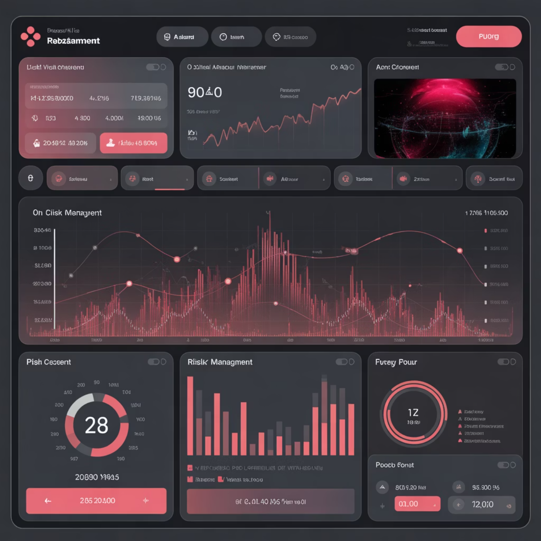

Risk Heatmap: Where It Breaks First
Not all supply risks are equal. This heatmap prioritizes vulnerabilities by likelihood and impact, guiding resource allocation toward the most consequential scenarios. Single-sourced mature-node components and OSAT constraints remain top concerns.
Risk
Likelihood
Impact
Notes
Single-sourced MCU (40nm, AEC-Q100)
High
Severe
12–18 month requalification; safety-critical
OSAT lockdown or labor shortage
Medium
High
Throughput shock across packages
Export control change
Medium
High
Sudden BOM redesign or supply rerouting
8-inch tool scarcity
High
Medium
Prolonged mature-node constraints
Logistics bottlenecks
Medium
Medium
Regional shutdowns; port congestion
Quality excursion at supplier
Low
High
Field actions; scrap and rework
Monitoring Cadence: Revisit risk heatmap quarterly; escalate high-likelihood/high-impact scenarios to executive steering immediately.

Slide 11
Resilience Playbook: From Firefighting to Foresight
Resilience requires moving beyond reactive firefighting to proactive, multi-functional capabilities. Organizations that embedded governance, supply diversification, and engineering agility during the shortage are better positioned for future disruptions.
Governance & Data
Supply & Commercial
Engineering & Product
Actions:
Actions:
Actions:
Central BOM risk registry with part-to-node mapping
LTA and capacity reservations for top 50 risk parts
Alternate-approved parts list (AAPL) and design abstraction
Second-source roadmap; dual OSAT where feasible
Allocation cockpit: confirmed-to-book (CTB), PPV, lead-time telemetry
DFM standards for package/pinout/voltage agility
Supplier segmentation and joint recovery drills
Qualification fast lanes for non-safety critical SKUs
Quarterly risk reviews with executive steering
Implementation Roadmap
Quick Wins (0–6 months)
Foundational (6–18 months)
SKU rationalization of low-velocity variants
Node-diversified product platforms
Safety stock tiers by criticality
AP-enabled planning (event-driven scenarios)
Transparent EAU forecasts to suppliers
Advanced test capacity buffers
Allocation tracking dashboards
Cross-functional risk governance model

Slide 12

Timeline: Shock, Squeeze, Response, Recovery
The semiconductor shortage unfolded in four distinct phases, each demanding different strategic responses. Understanding this arc helps organizations prepare for the next disruption and embed resilience during periods of relative stability.
2020 H1: Shock
2022: Response
Auto demand collapse and order cancellations
Major capacity announcements from foundries
Early fab and OSAT disruptions from COVID-19
Policy incentives unveiled (CHIPS Acts)
Demand forecasts revised downward
Peak lead times reached at mature nodes
Resilience investments: AAPL, LTAs, dual-source plans
1
2
3
4
2020 H2 – 2021: Squeeze
2023: Recovery
Sharp rebound plus work-from-home surge
Lead times normalize unevenly across categories
Double-booking behavior amplifies shortages
Memory cycles down; automotive remains tight early year
Weather events, fires, and lockdowns create cascading constraints
New fab construction underway
Ongoing risk monitoring and governance embedding
Lead times begin steep climb
Lesson Learned: Resilience must be built during the 'Response' and 'Recovery' phases when capital and attention are available. Waiting for the next 'Shock' guarantees reactive, high-cost firefighting.

